Slide 1
PIZZA SALES ANALYSIS

Slide 2
Introduction
This project aims to analyze and visualize key business insights from a dataset using a combination of MySQL, Excel and Power BI. The objective is to leverage these tools to perform data cleaning, analysis and visualization, presenting a comprehensive understanding of the dataset for the decision-making purpose. It involves examining various aspects of pizza orders to understand customer behavior, identify trends, and optimize business strategy.

Slide 3
Key performance indicator
Total revenue: 817.86K
Total pizza sold: 49574
Average pizza per order: 2
Total orders: 21350
Average order value: 38

Slide 4
Insights
Total orders by day: orders are highest on weekends on Friday/Saturday evenings – 3.2k to 3.5k
Total orders by month: the maximum of orders are from month jan, July and may – 1845 to 1935
% of sales by pizza category: classic pizza category contributes to maximum sales and total orders – sales is 26.91% and total order is 14888
% of sales by pizza size: Large size pizza contributes to maximum sales – 45.89%
Top and bottom 5 pizza by total revenue: the thai chicken pizza contributes to maximum revenue and brie carre pizza is having minimum revenue – thai chicken is 43k and brie carre is 12k.
Top and bottom 5 pizza by total quantity: the classic deluxe pizza contributes to maximum quantity and brie carre pizza is having minimum quantity – classic deluxe is 2.5k and brie carre is 490.
Top and bottom 5 pizza by total orders: the classic deluxe pizza contributes to maximum total orders and brie carre pizza is having minimum total orders – classic deluxe is 2.3k and brie carre is 480.

Slide 5
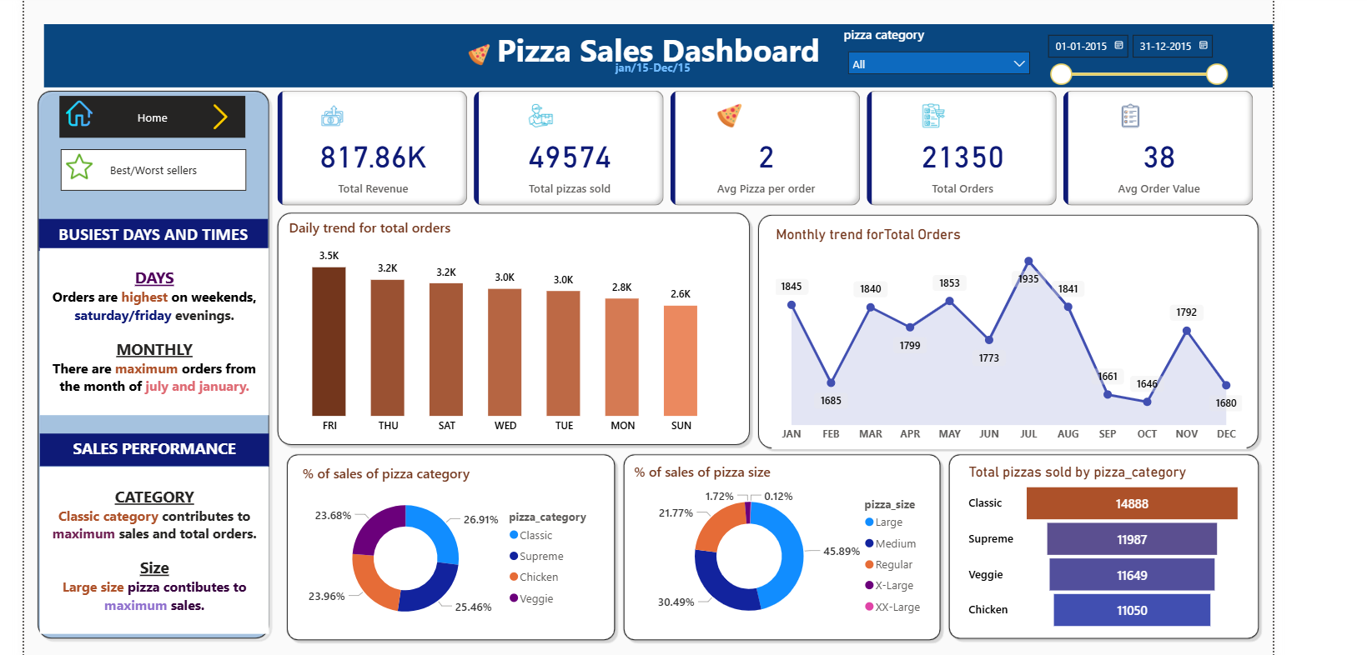
dashboard

Slide 6
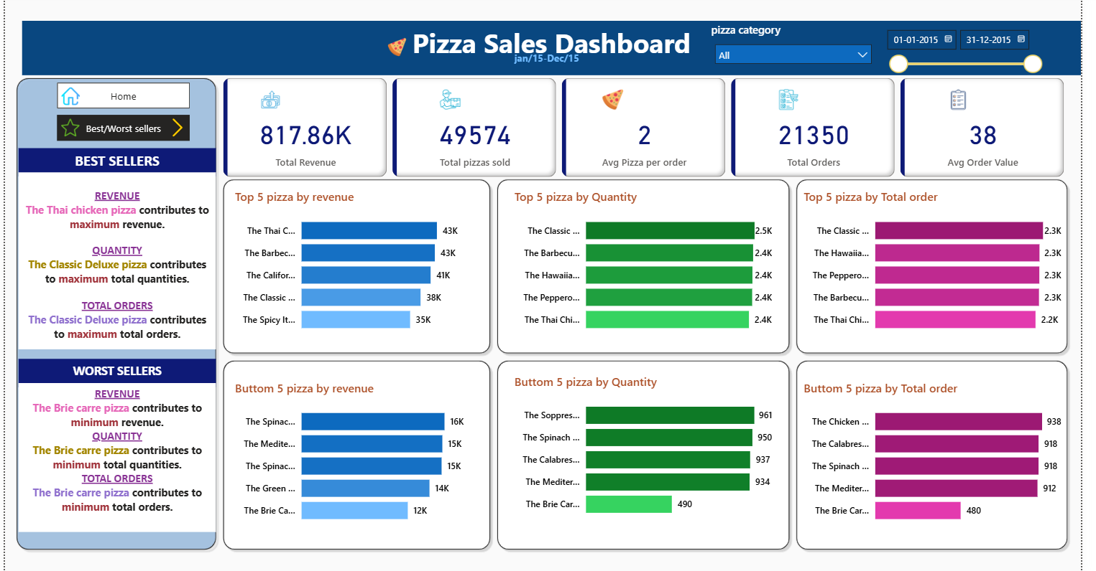

Slide 7
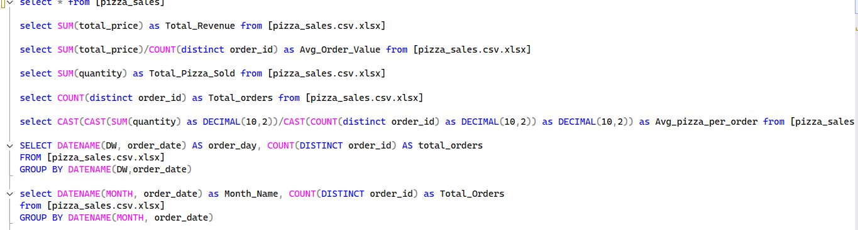
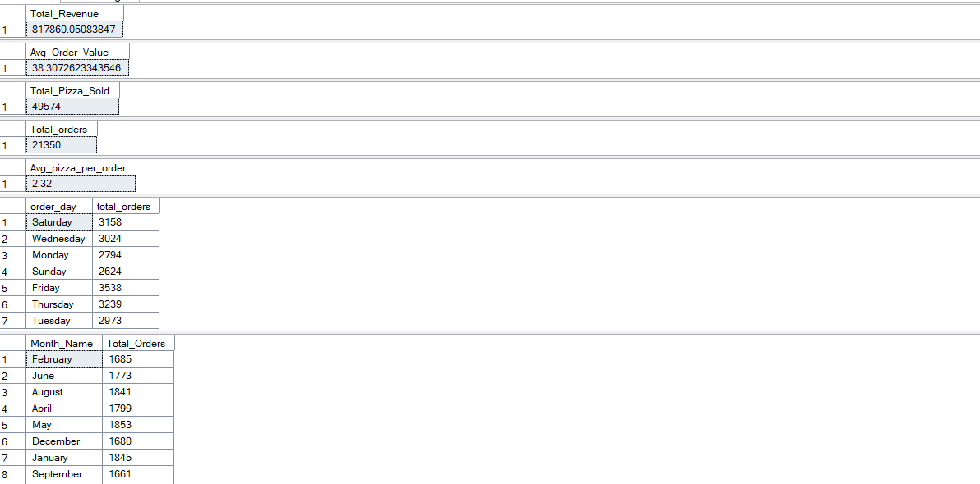
Sql queries output

Slide 8
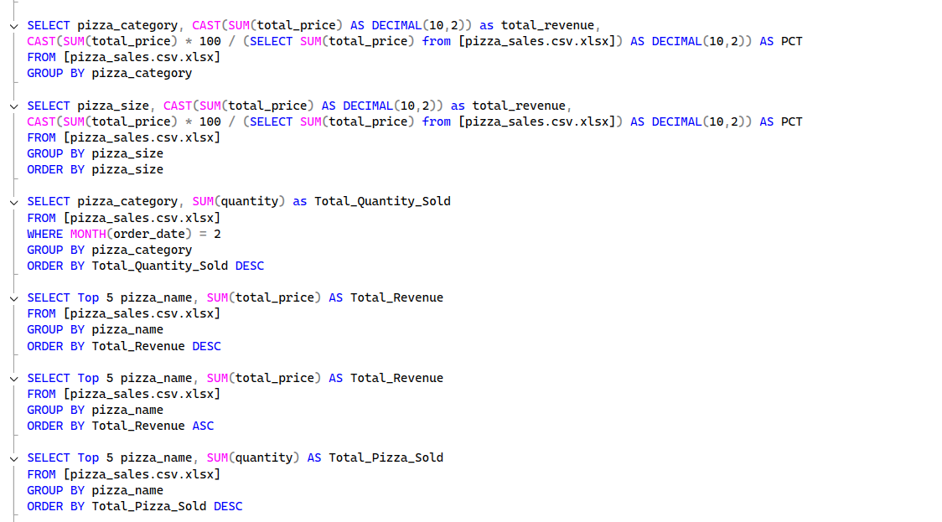
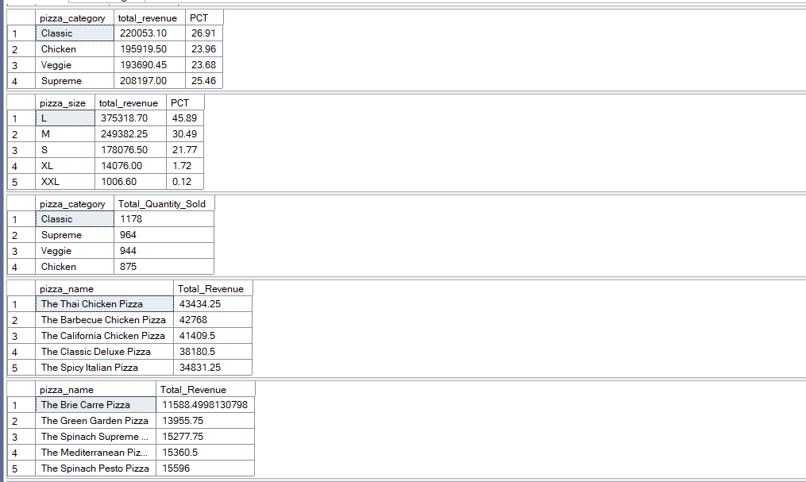

Slide 9
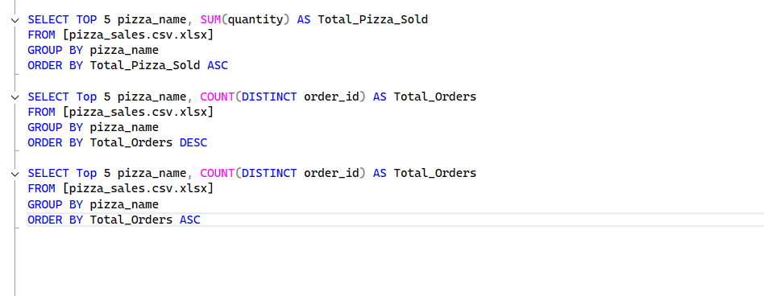
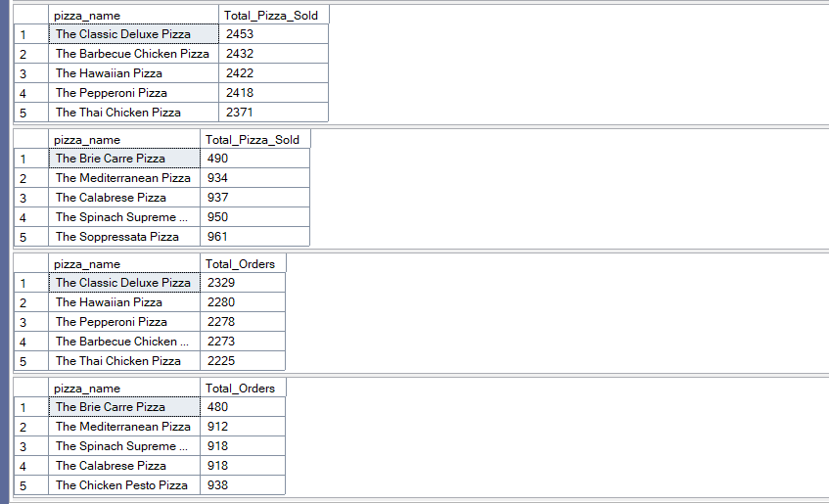

Slide 10
conclusion
The pizza sales dashboard provides a clear data-driven overview of key performance metrices, offer valuable insights into total revenue, total orders and total pizzas sold. It helps identify the areas of which pizza category and size are maximum sold, on which days and month of the year the pizza sales are high, pizza contributes to maximum and minimum revenue, quantities, total orders and which pizza sales are worst. This dashboard is a useful tools for informed decision-making and strategic planning, enabling better performance tracking and operational optimization.

Slide 11
Thank you

